Slide 1
C0llege of Technology Pantnagar
Topic-8 mega construction project in india watch out for 2023
Submitted by -Dixa
Id-54829

Slide 2

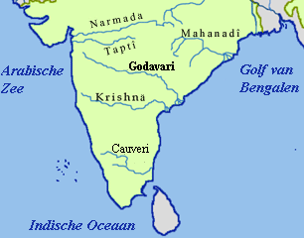
NARMADA VALLEY DEVELOPMENT PROJECT
The project involves constructing a series of dams and canals along the river basin to generate electricity and provide irrigation and drinking water .Sardar Sarover dam ,1450MW hydroelectric project dam ,is also part of NVD project.

Slide 3

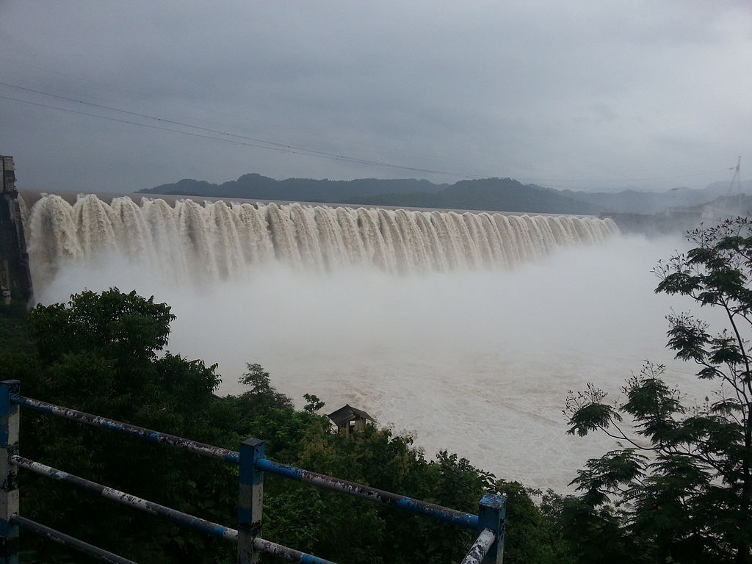

1. Intro
Choose one approach to grab the audience’s attention right from the start: unexpected, emotional, or simple.
Unexpected Highlight what’s new, unusual, or surprising.
Emotional Give people a reason to care.
Simple Provide a simple unifying message for what is to come

Slide 4
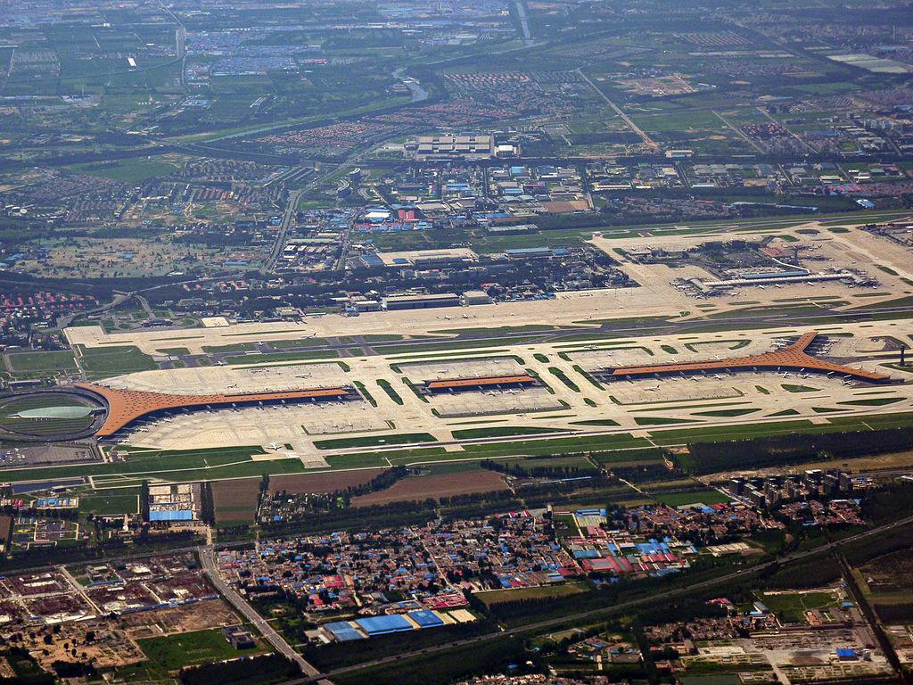
Navi mumbai international airport
The navi mumbai international airport in south mumbai is an under-construction airport in navi mumbai. The airport is mumbai second international airport after the chatrapati shivaji maharaj international airport
Tip
In this example, we’re leading off with something unexpected.
While the audience is trying to come up with a number, we’ll surprise them with the next slide.

Slide 5
Chenab River Railway Bridge
It is the highest railway bridge in world ,standing at at staggering 359metersabove the chenab river Your own.
Tip
Remember. If something sounds like common sense, people will ignore it.
Highlight what is unexpected about your topic.

Slide 6
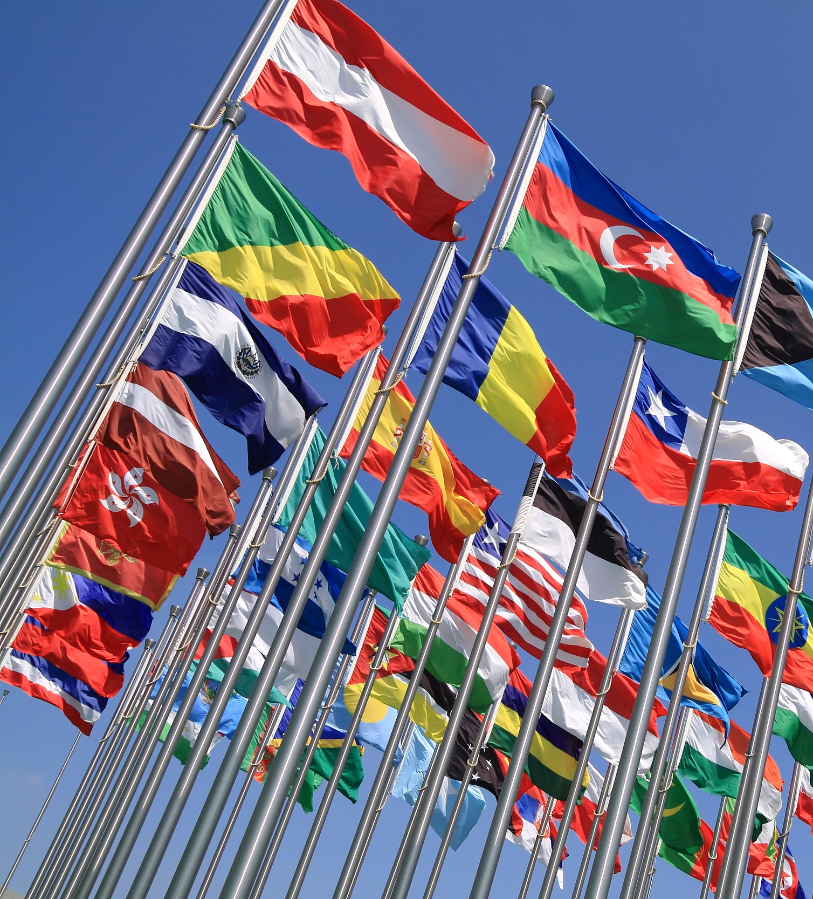
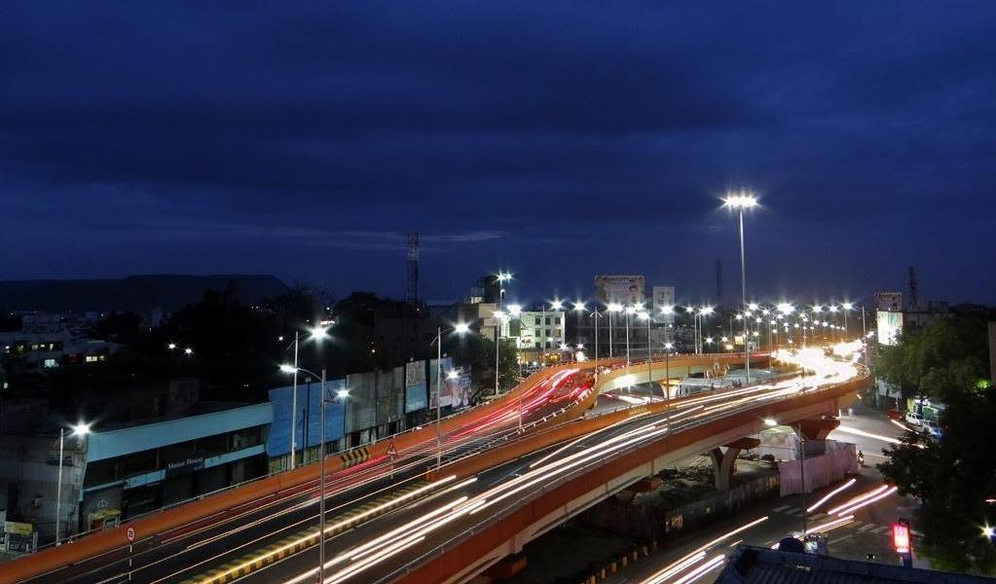
The Delhi- Mumbai Industrial Corridor
The delhi-mumbai industrial corridor is major infrastructure project launched by government of india in 2007.it aims to develop a sustainable and high quality industrial infrastructure along the delhi mumbai freight corridor, which one of the busiest freight corridors in the world.
Tip
Don’t wait till the end of the presentation to give the bottom line.
Reveal your product or idea (in this case a translation app) up front.

Slide 7
BHARATMALA PROJECT
Bharatmala is a highway construction project launched by goverment of india in 2017.
The project baims to improve connectivity in th country by constructing approximaatelyn 34800km of natianal highways and boader roads.

Slide 8

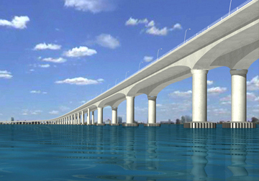
Mumbai trans harbour link.
It is a freeway -grade road bridge being constructed to connect mumbai and navi mumbai.
Tip
Tell the audience about the problem through a story, ideally a person.

Slide 9

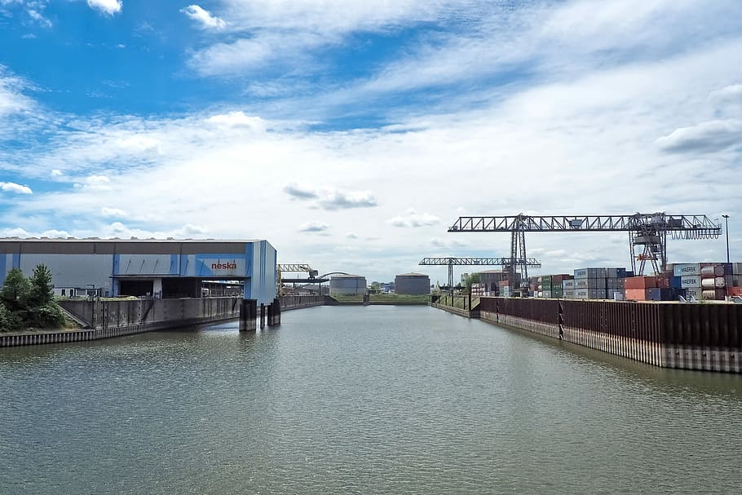
Inland waterway development project.
The goverment has stepped up to develop inland waterways as an alternative ,cheaper and greener means of transporting cargo and freight.
Tip
If one example isn’t sufficient to help people understand the breadth of your idea, pick a couple of examples.

Slide 10
THANK YOU \

